Slide 1
INTRODUCTION
Formula Hybrid Competition is run on set of rules, based on some standards set by SAE International and IEEE committee.
This involves in designing the Hybrid race car following the standards provided by the SAE and IEEE.
The competition themselves give teams the chance to demonstrate and prove both their creativity and their engineering skill in comparison to teams from other universities around the world.

Slide 2
OBJECTIVE
To design and implement the Primary Electrical drive train and safety system following the standards provided by Formula Hybrid Committee.

Slide 3
PRIMARY ELECTRICAL SYSTEM
It is divided into two parts—
1) HIGH VOLTAGE SYSTEM
2) LOW VOLTAGE SYSTEM

Slide 4
High voltage system includes electrical power train, which consists of battery, controller, motor , power cables and some safety switches.
Low voltage system includes battery , switches , control circuitry, relays and other safety devices like IMD.

Slide 5
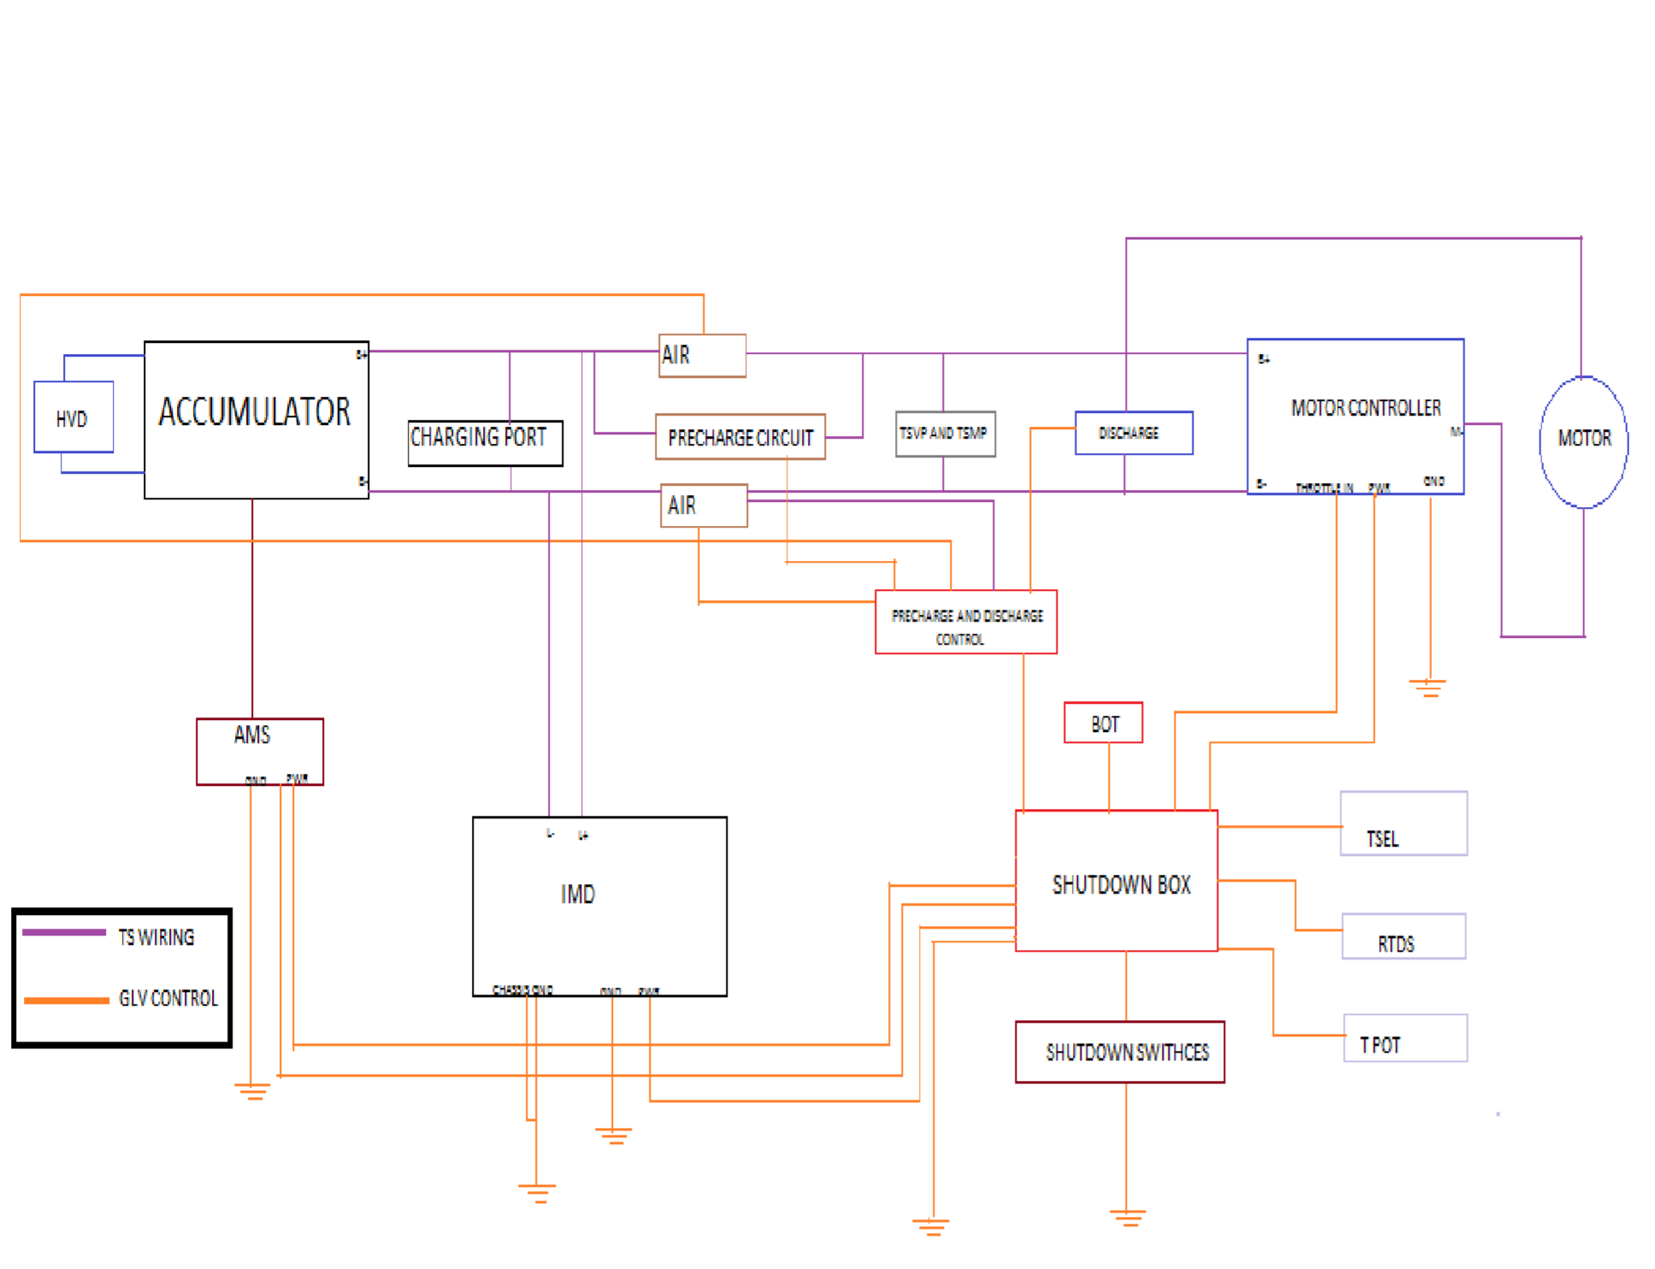
OVERALL CIRCUIT

Slide 6
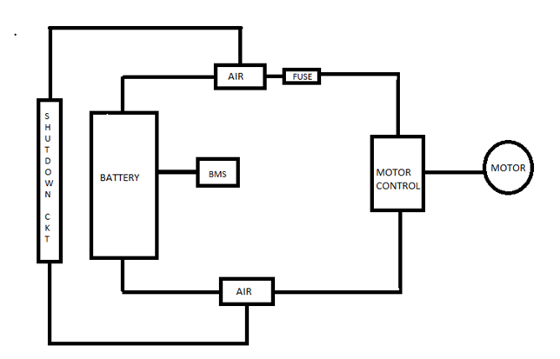
BLOCK DIAGRAM OF HV SYSTEM

Slide 7
SELECTION OF HV COMPONENTS
Motor selection is based on the required acceleration ,torque , rpm , power needed to drive the car.
Pel =Pmech + Pj (losses)
Prot = T*w
Acceleration required = 1.5 m/s^2
Torque required = 619.125N-m
RPM required = 217 rpm
Required power = 14.066 Kw
Based on these parameters , we selected our motor as Agni 95

Slide 8
Controller can be selected based on the parameters of Motor.
We have 48 volt system, so max output of controller should be 48v .
But we selected the controller as 24 – 120v output due to availability issue.
We can limit the output of controller by configuring the controller or limiting the input acceleration signal provided by Accelerator pedal.
We selected our controller as High efficient Kelly controller(DC).

Slide 9
Energy requirement and Battery , fuse selection
Battery selection
We are having 14 Lithium ion batteries with voltage as 3.3 v per cell. The ampere capacity of each cell is 100Ah.
So total energy it can provide is 3696Wh ( 14*3.3*100*80%)
High voltage Fuse selection
Fuse has to be selected based on the theoretical calculations of Maximum Continuous and Short circuit current of the HV system.
Maximum Continuous current should be 100 amps as it is the rated value of battery.
The voltage rating must be at least the maximum voltage in the system which is 48V.
SC rating = 48/series resistance
Series resistance = cable resistance + Battery pack internal resistance

Slide 10
Cable resistance = resisivity * length/ area
= 1.68*10^-8* 1.5 / 50 *10^-6
= 50.4 milli ohm
Series Resistance = 50.4 m + 0.6m = 51 m ohm
SC rating = 48/ 51m
= 941 amps
So, we have selected a 100 amps continuous rating fuse with a SC handling rating which is more than 1000amps.
Coopper bussmann – ANL100 is the fuse model, Which is a slow blow in chara.

Slide 11
Precharge and discharge circuitry
Precharge and discharge of the controller is the one of the important task to achieve.
Precharge time can be found from simulated graph, we can control the precharge relay by using the MEWYEAH BMS.
Discharge can be done by closing the discharge path with a power resistor.
Precharge time is roughly taken as 3 sec and discharge time is taken as sec based on following calculations.

Slide 12
Energy in the input capacitor of the motor controller is dissipated through the Discharge resistor.
0.5 * C * V^2 = V^2 / R
0.5*4512*10^-6 * 48^2 = 48^2 / X
X=R= 443 OHM
R is rounded off to 500 ohm

Slide 13
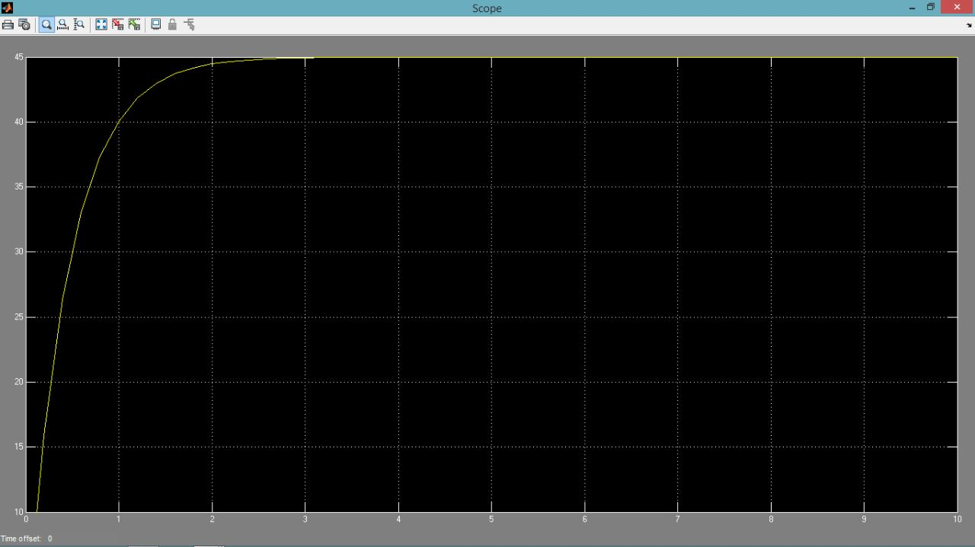
PRE CHARGE GRAPH
V=48V, R= 50.4 M OHM , C=4512 MICRO F

Slide 14
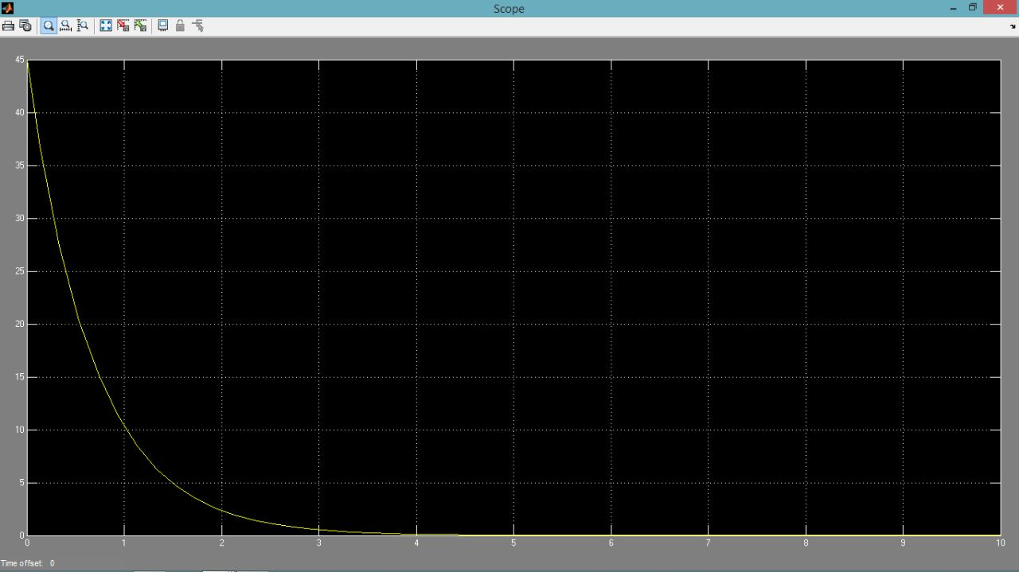
DISCHARGE GRAPH C=4512 MICRO F, R=X

Slide 15
SUB DIVISIONS OF GLV and SAFETY SYSTEM
SHUTDOWN SYTEM
CONTROL AND SAFETY SYSTEM
Includes Brb’s, relays, Glv source.
Includes Control PCB board, arduino , sub control boards for different parts.

Slide 16
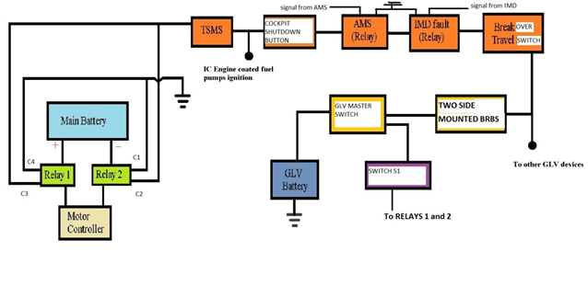
SHUTDOWN SYSTEM

Slide 17
Control System
Primary PCB Board---- Controls the AIR relays at different shutdown cases in car.
Arduino – Controls the time of switching of all types of relays used in PCB main board using relay drivers.

Slide 18
PRIMARY PCB BOARD INCLUDES LATCH , BMS , IMD , FAULT CUT OFF

Slide 19
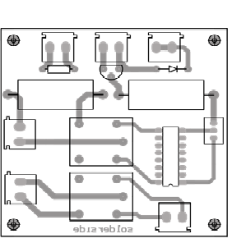
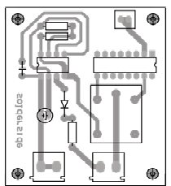
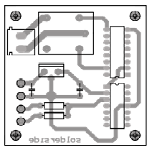
SUBCONTROL BOARDS
Precharge and discharge
TSVP LIGHT
HV FLASH LIGHT

Slide 20
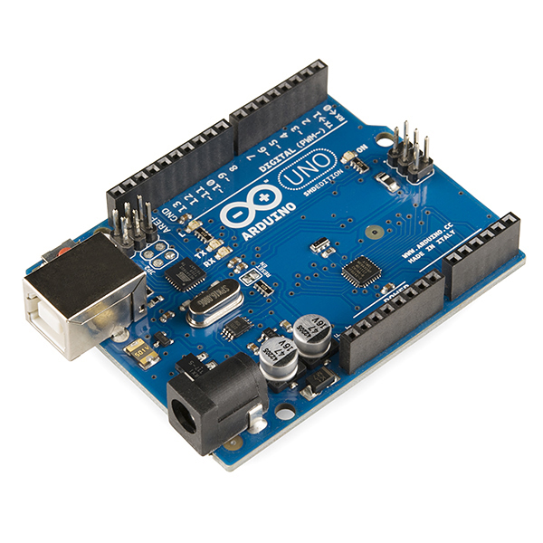
ARDUINO

Slide 21
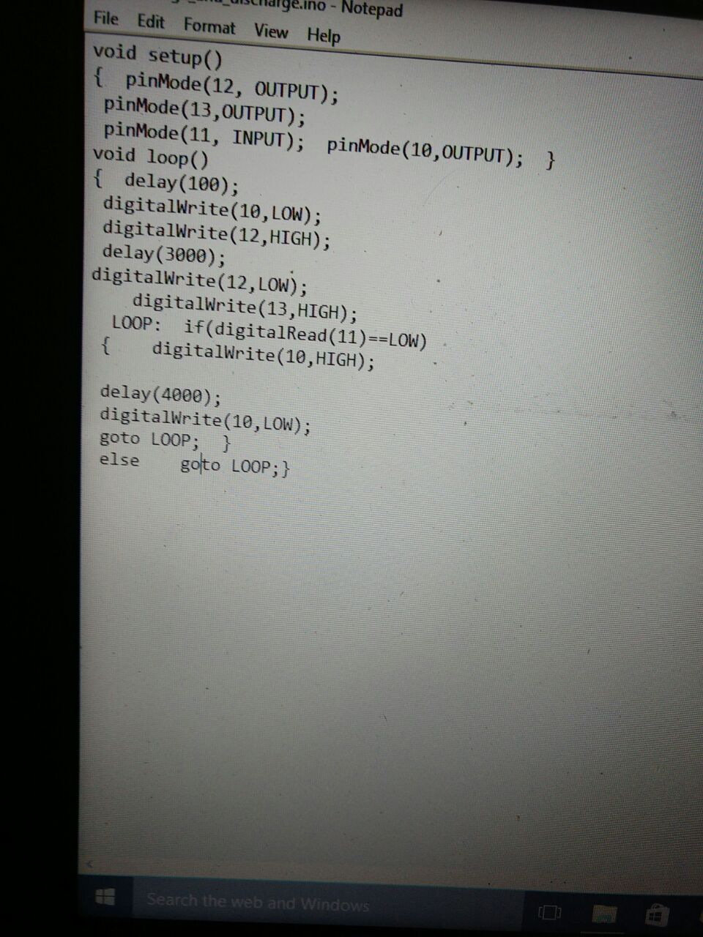
INSTALLED PROGRAM FOR PRECHARGE AND DISCHARGE CONTROL

Slide 22
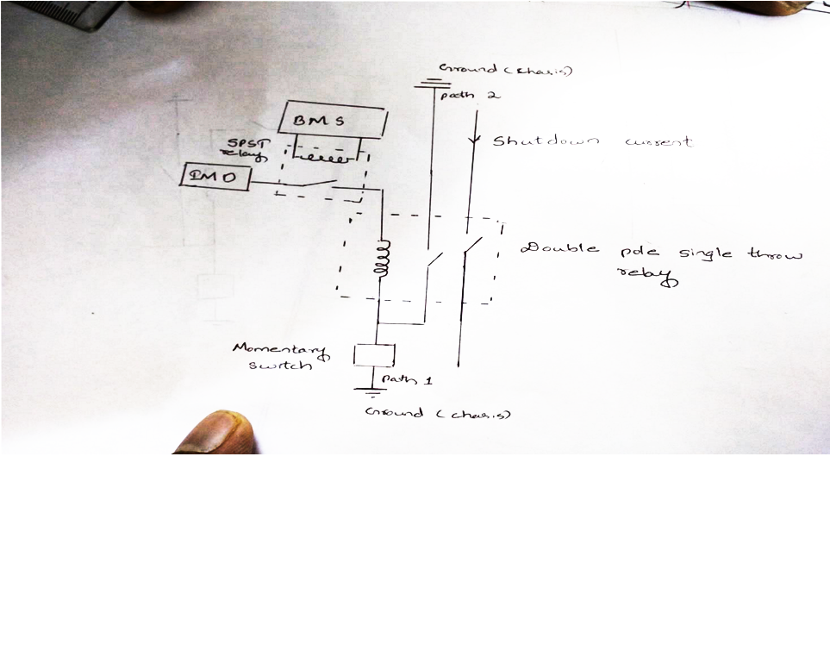
First using the momentary switch excitation to the double pole single throw relay is given thereby energizing it through the path 2 when we release the momentary switch. In case of faults the relay coil is no more energized so both the switch opens. Only when we press the momentary switch the relay coil will be energized again. The momentary switch is the reset switch.

Slide 23
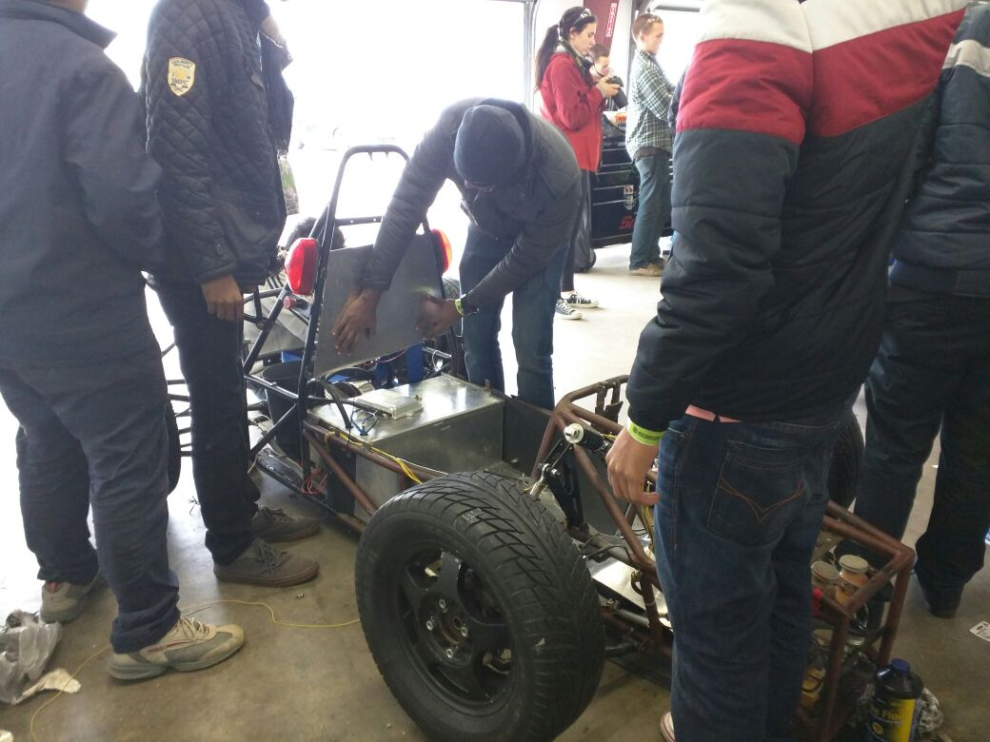
Electrical drive train display

Slide 24
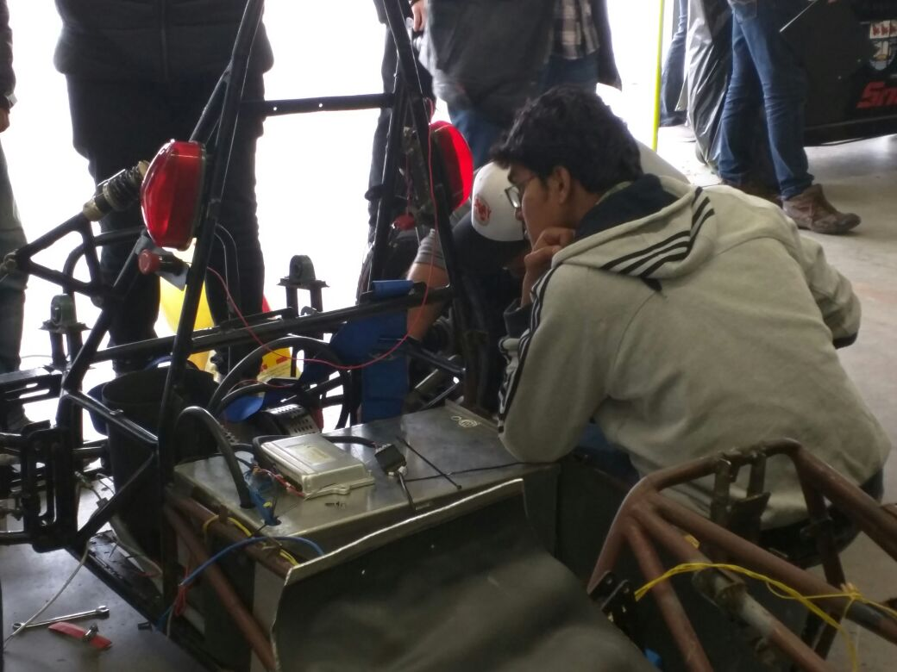

Slide 25
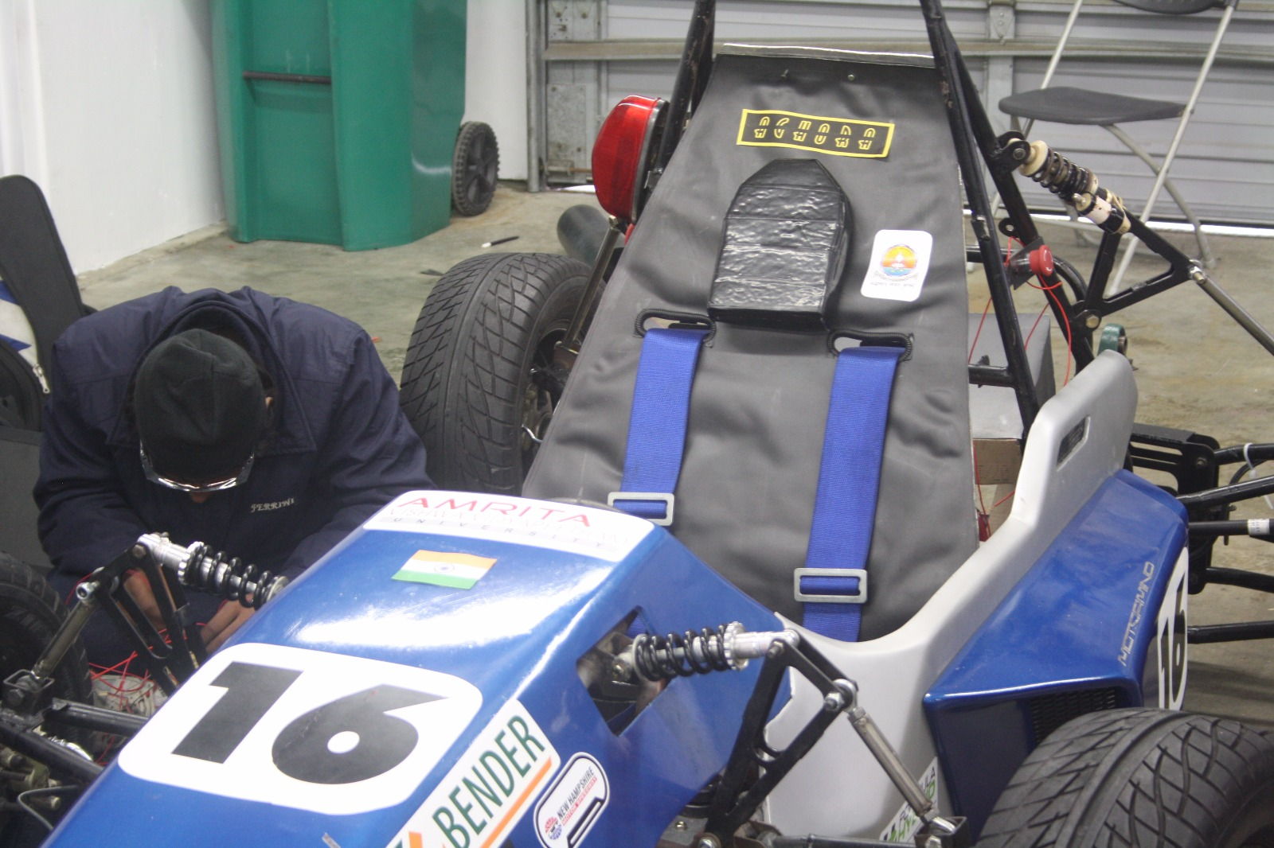

Slide 26
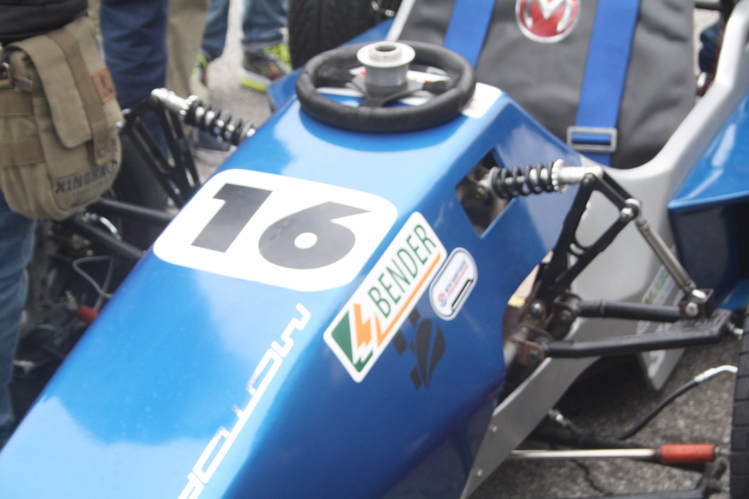
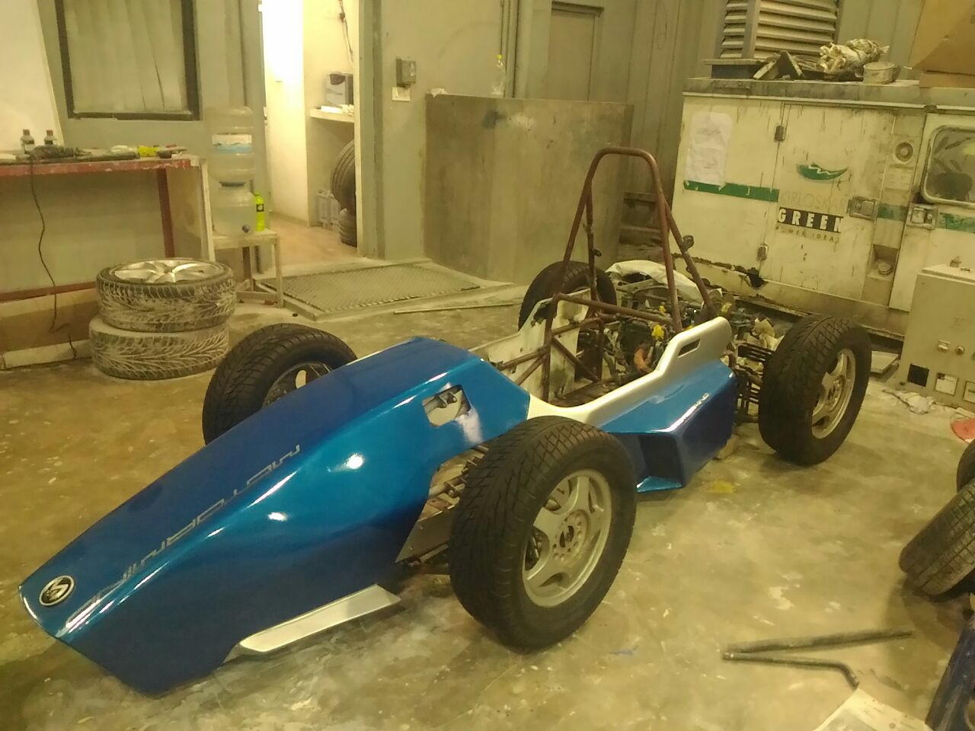
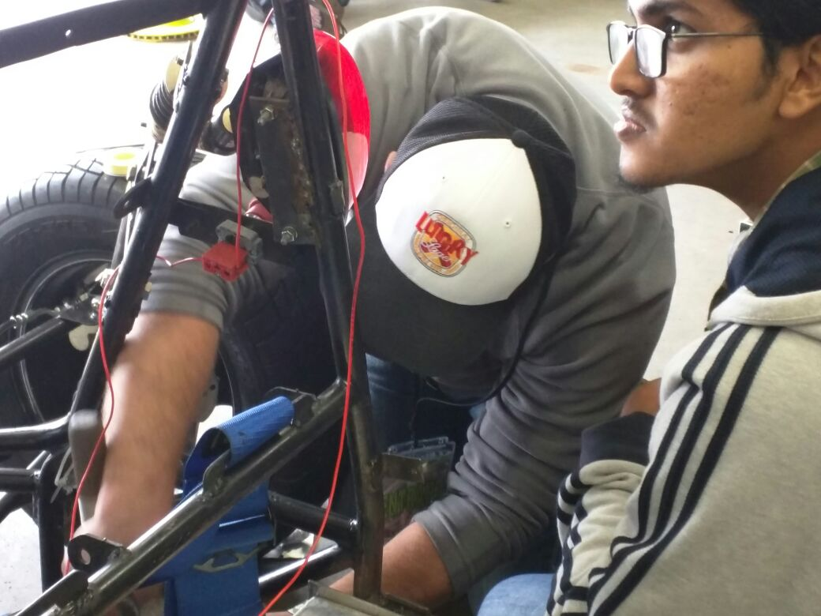

Slide 27
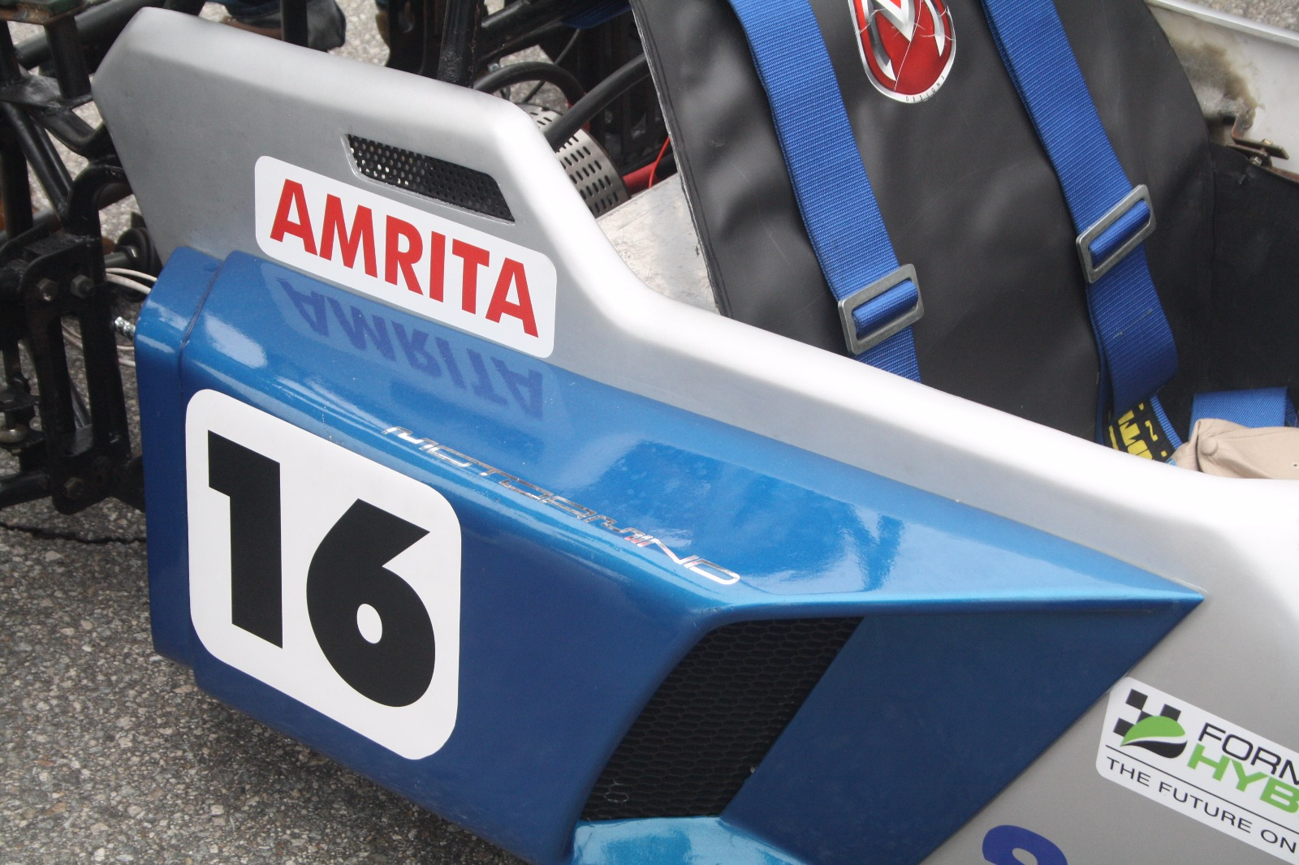

Slide 28
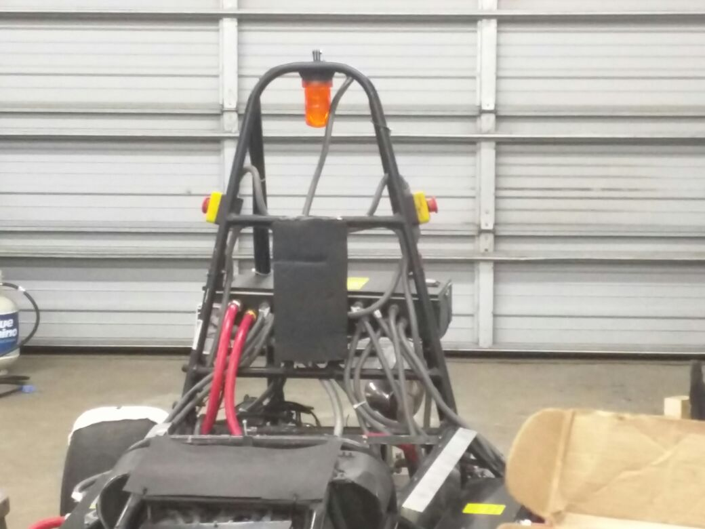
OTHER TEAM CAR

